Slide 1
LEARNER SPANISH ON COMPUTER. THE CAES ‘CORPUS DE APRENDICES DE ESPAÑOL’ PROJECT
IGNACIO M. PALACIOS MARTÍNEZ
DEPARTAMENTO DE FILOLOGÍA INGLESA Y ALEMANA
UNIVERSIDADE DE SANTIAGO DE COMPOSTELA

Slide 2
The CAES Project
This presentation will be organised in two parts :
The first part will be dealing with the origin, development and description of the project.
The second will be concerned with a study derived from the analysis of data extracted from the corpus. This study, which will be centred on false friends, can be considered as a simple example of the kind of research that can be conducted with this tool.

Slide 3
The CAES Corpus: General Features
Computerised Corpus of Spanish as a foreign language.
Financed by the Cervantes Institute (CI).
Carried out by a research team from the University of Santiago (Guillermo Rojo and Ignacio Palacios as directors).
Compiled between 2012-2014.
It contains almost 600,000 words.
Written material only for the time being.

Slide 4
The CAES Corpus: General Features
5 proficiency levels represented: from A1 to C1.
Learners from 6 different L1 : English, French, Arabic, Portuguese, Russian & Mandarin Chinese.
1423 participants from over twenty different countries (502 male & 921 female).
Participants’ age ranged from 15 to over 61.

Slide 5
Table 1. Main features of the CAES project
Compilers | Participants' native language |  | Participants' gender |  | Participants' level |  | Participants' main countries represented
(Rojo, Palacios, et al.). | Arabic Portuguese English French Mandarin Chinese Russian | 497 361 227 143 128 67 | male female | 521 902 | A1 A2 B1 B2 C1 | 526 421 252 162 62 | Brazil Morocco USA China France Siria Russia Afghanistan Ireland Algeria Portugal Lebanon Jordan Tunisia | 319 312 139 127 92 70 62 52 38 32 31 26 21 16

Slide 6
The CAES corpus
Table 2. Participants’ distribution according to their L1 and proficiency level
 | Arabic | Chinese | French | English | Portuguese | Russian
A1 | 599 | 189 | 132 | 77 | 494 | 66
A2 | 364 | 100 | 88 | 344 | 257 | 58
B1 | 232 | 69 | 85 | 127 | 123 | 41
B2 | 99 | 15 | 48 | 41 | 99 | 11
C1 | 48 | 0 | 18 | 26 | 28 | 0

Slide 7
The CAES Corpus
Table 3. Participants’ distribution according to their proficiency level
Proficiency level | Elements | Sample units
A1 | 155 458 | 526
A2 | 178 834 | 421
B1 | 116 520 | 252
B2 | 80 556 | 162
C1 | 42 350 | 62

Slide 8
The CAES Corpus
Table 4. Participants’ distribution according to their L1
L1 | Elements | Sample units
Arabic | 168 231 | 497
Mandarin Chinese | 53 163 | 128
French | 58 412 | 143
English | 106 968 | 227
Portuguese | 165 231 | 361
Russian | 20 713 | 67

Slide 9
The CAES Corpus
Table 5. Participants’ distribution according to their gender
Table 6. Participants’ distribution according to age
Gender | Elements | Sample units
Male | 207 992 | 521
Female | 365 726 | 902
Age | Elements | Sample units
>=15 - <=21 | 200 696 | 498
>=22 - <=30 | 187 311 | 466
>=31 - <=40 | 76 674 | 196
>=41 - <=60 | 83 750 | 198
>=61 | 25 287 | 65

Slide 10
The CAES Corpus: Stages in its compilation
Stage 1: Before the data collection
Computer programme created for the data collection so that participants themselves could enter the data directly in the computer.
Protocol prepared and distributed among all the centres that participated in the data collection.
Computer programme for data collection was piloted with several groups of students.
Participants signed a consent form for the use of the data obtained.

Slide 11
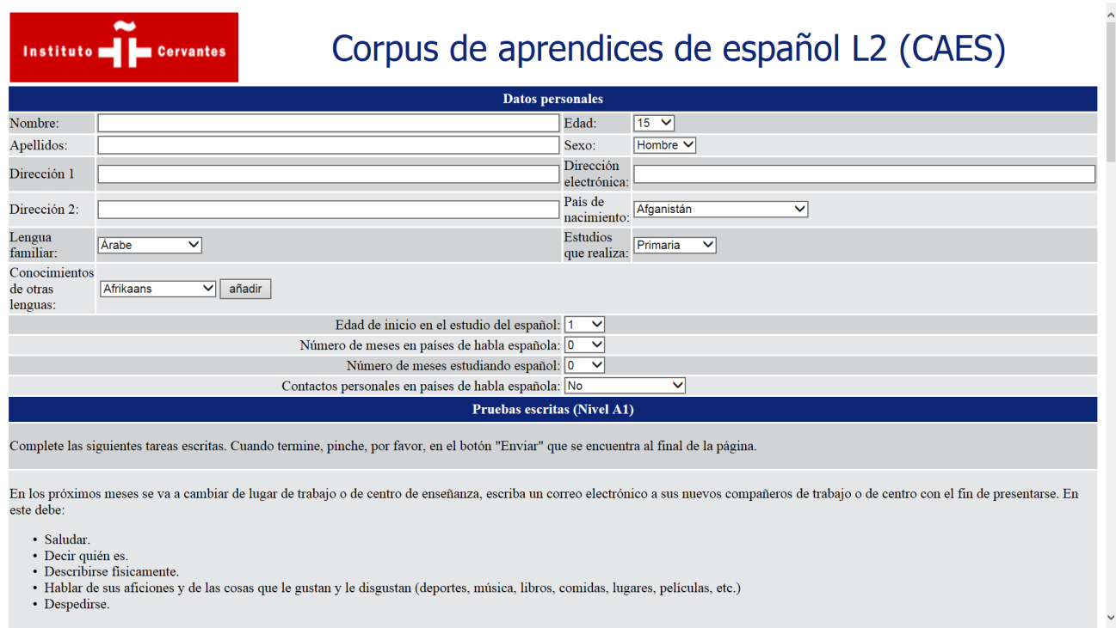
CAES Project
Figure 1. CAES general interface for data collection

Slide 12
CAES project
Stage 2: While the data collection
Participants had to complete a number of written tasks (3 on average).
These tasks were designed according to the CEFR descriptors and DELE tests as well as in accordance with the CI’s General Curricular Document.
Examples of activities:
Writing emails to friends & relatives
Critical review of a book
Applying for a job
Booking a hotel room
Making a complaint
Writing a funny story

Slide 13
CAES project
Stage 3: Text encoding and annotation
The texts integrated into CAES adopt the format of XML documents.
The texts were tagged both automatically and manually. A total of 702 different tags were used.
FreeLing, an open source language analysis tool suite, was used to make the necessary adjustments of the equivalences between the FreeLing tagging system and the one our team intended to use.
Finally, the texts were manually disambiguated.

Slide 14
CAES project
Stage 4: The search tool
It retrieves statistical information and textual examples of elements, lemmas, word classes and gramatical categories with filters (learner’s L1 and level of proficiency, age, sex, country of origin, etc.)
It gives the possibility of distinguishing between lower and higher case words, accented or non-accented.
Searches based on co-occurrence of several elements can also be conducted.

Slide 15
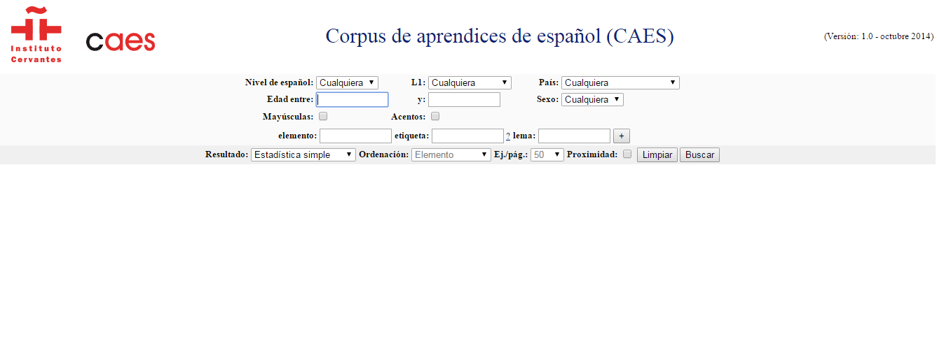
CAES project
Figure 2. CAES search tool

Slide 16
PART II: STUDY ON FALSE FRIENDS
Introduction
False friends definition: lexical items whose forms are identical or similar to words in the L1 but whose meanings are different.
FF classification: orthographic, phonetic, semantic, contextual, total and partial.
Total: Sp. Librería vs. Eng. Library
Partial: Sp. Circulación vs. Eng. circulation

Slide 17
STUDY ON FALSE FRIENDS: PURPOSE
To see the extent to which these lexical items are present in a learner corpus of this size.
To explore whether they are problematic words or not.
To investigate how they are actually used and what information we can gather from the corpus material.
To examine how these lexical items varied from one L1 to another given that the corpus contained samples of learners from 6 different language backgrounds.

Slide 18
STUDY ON FALSE FRIENDS: FINDINGS
False friends do cause difficulties for learners of Spanish.
They are mostly found at the initial stages of language learning, that is, A1 and A2 levels although they are present across all proficiency levels.
Let’s consider some examples:
English-Spanish: suburb/suburbio, idiom/idioma, firm/ compañia, move/trasladarse, determined/ decidido/a, involve/implicar, large/grande
French-Spanish: campagne/campiña, civilisation/cultura, sentiment/impresión
Portuguese/Spanish: aula/clase, romance/novela, brincar/ bromear, combinar/quedar, balcâo/mostrador

Slide 19
Table 2. Examples of English-Spanish false friends identified in the corpus
English | Spanish | Corpus example | Students’ level
move | trasladarse | Lawrence nacio en Pincicolla, Florida en 1975 pero movía a Idaho cuando era muy joven. | A1
large | grande | John y los otros hombres que eran en la ceremonia llevaron sombreros largos. | A2
realise | darse cuenta | La comé la comida misteria y realicé que era pollo! | B1
provide | proporcionar | ¿Es posible todavía obtener un lugar en la resendencia universitaria o pudiese aconsejar me con unas agencias que provienen acomodación? | B2
in addition | además | En adición, tuve que ir a la casa de mi hermano. | C1

Slide 20
Table 3. Examples of French-Spanish false friends identified in the corpus
French | Spanish | Corpus example | Students’ level
campagne | campiña, campo | Visitamos a Oxford, Dublin y la campaña irlandesa. | A2
se trouver | conocerse | Encontramos en 2001 cuando veni en Pariz por mis estudios. | A2
cuisiner, f aire la cusine | cocinar | A veces hago la cocina en casa. | A2
concours | concurso | Cuando el solo tenía 16 años, fue en la competición de X Factor. | A2
large | ancho/a | Mi maleta es muy larga y de plástica roja. | B1
succès | éxito | esperé sin suceso la salida de mi bolso a la llegada | B1
entendre | oir | Soy madame xxxx habia entendido buenas noticias de vuestra compañia ... | C1

Slide 21
Table 4. Examples of Portuguese-Spanish false friends identified in the corpus
Portuguese | Spanish | Corpus example | Students’ level
combinar | quedar, concertar | No puedo llegar la hora combinada. | A1
 |  | después encontrarme con mis padres en el lugar combinado. | A2
sucesso | éxito | Su marido hico muchas músicas de suceso en Brasil. | A2
contestar | manifestarse, protestar | Escribo les para contestar sobre mi equipaje que no ha venido junto a mí en el viaje. | B1
lecionar | enseñar, impartir clase | Quantos professores lecionan en cada curso? | B2
passar | tener lugar, acontecer | pelicula esa se pasa en una barrio de Salvador de Bahía que nombra la película. | C1
 |  | La historia se pasa en Brasil en 2012. | B1

Slide 22
WORDCOINAGES
Interlanguage word | Target language word
hermosidad | hermosura
contadora | contable
opinas | opiniones
excepcionarios | excepcional
excepcionista | excepcional
inhibitó | habitaba
hicimos la decisión | tomamos la decisión

Slide 23
WORDCOINAGES
Interlanguage word | Target language word
seriosa | seria
inexpectados | inesperados
ensolada | soleada
reservación | reserva
fumante | fumador
solicitación | solicitud
garantir | garantizar

Slide 24
CODE-SWITCHING/CODE-MIXING
“Mi madre es un accountant y ella es muy buena en matemáticas” (A2, English as L1)
“Me trabajo en un agency” (A1, Russian as L1)
“a continuar su trabajo en el mundo tercera como un ambassador official de el UN” /A2, English as L1)
“Entonces fuinos a la Cloud Forest y hacemos el Zip-line y la Tarzan junp” (A2, English as L1).
“Nosotros fuimos a la carnival de el Lago” (A2, English as L1).
“Entonves el le compró un anel de diamantes muy hermoso que le custó une pequeña fortuna!” (B1, Portuguese).
Vive en un apartamento pero le cuesto mucho pagar la rent (A1, English).

Slide 25
FURTHER WORK
Plans for incorporating new material:
- samples from more learners incorporating data from C2 level learners and from more L1.
- spoken data (video recording)
- error-tagging system?

Slide 26
FINAL REFLECTIONS
There is still great scope for further development. Corpus learner research has great potential for investigating how learners actually learn the foreign language.
Multiple applications of a learner corpus of this nature:
Spanish as a second language acquisition/learning research
Help for teachers in the planning of lessons.
Syllabus design.
Language teaching materials development.
The field of translation.
Implementing technological resources for the teaching of Spanish.

